Slide 1
Risk analysis of SPY and sector ETFs in machine learning
Phase I Presentation
Advisor: Khaldoun khashanah
PREPARED BY
Tan Tu Siyuan Liu
Zihao Gao

Slide 2
The outline of our project.
Download daily data of SPY and other 10 ETFs
Compute empirical VaR
Use Gram-Chailer Density to calculate the VaR
Analyze and compare two results
Use machine learning methods to predict the VaR
Mapping news of the extreme VaR change
Compute the correlation matrix of moving risk of ETFs in both cases empirical and parametric.

Slide 3
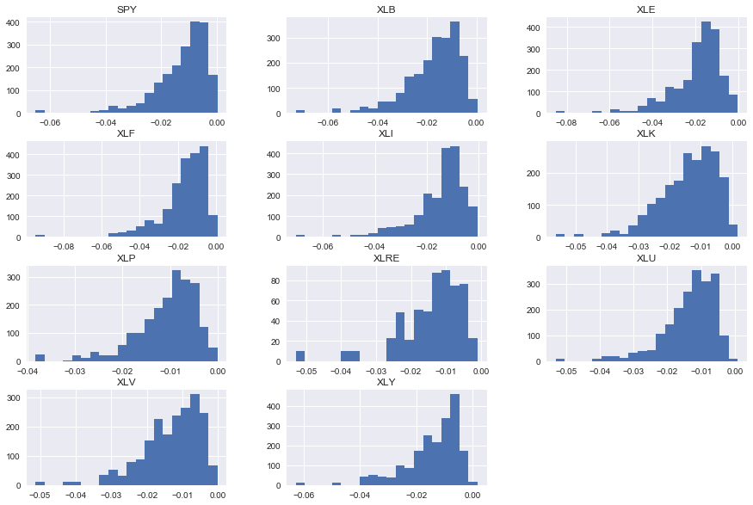
Rolling VaR with window 30 Days

Slide 4
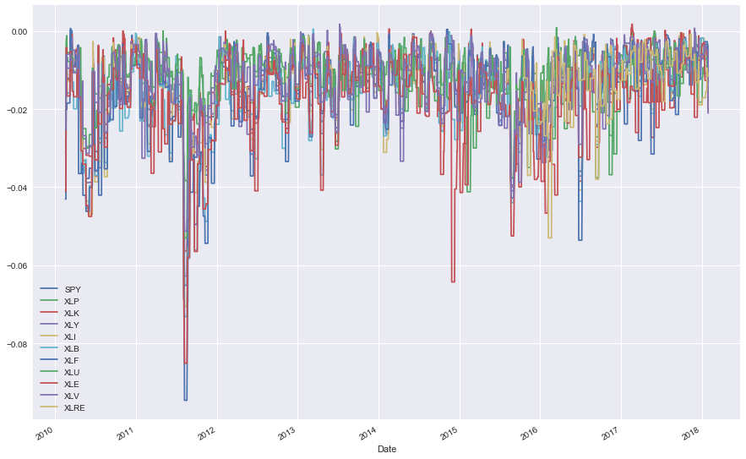
Rolling Var with window 30 Days

Slide 5
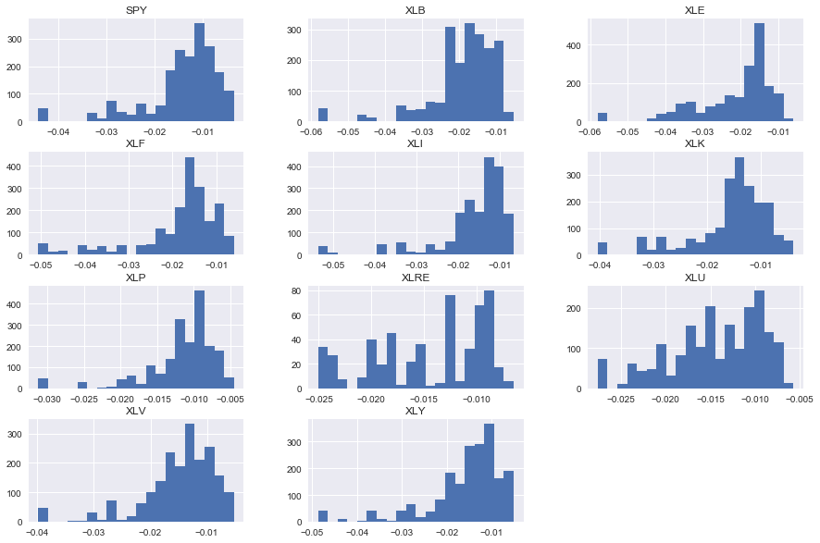
Rolling VaR with window 50 Days

Slide 6
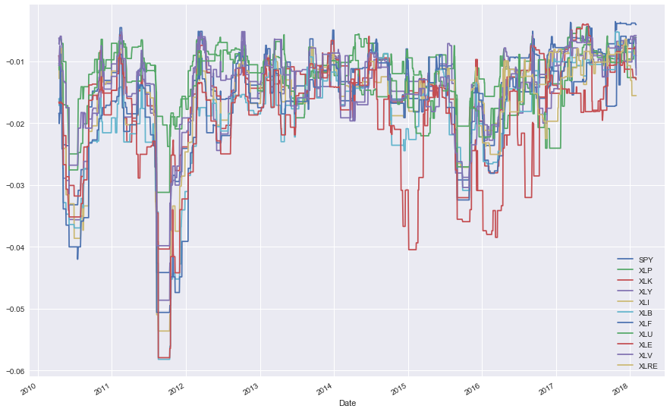
Rolling Var with window 50 Days

Slide 7
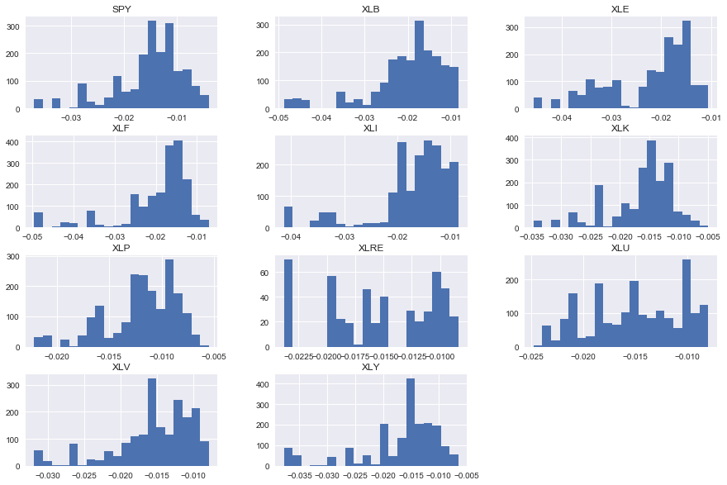
Rolling VaR with window 100 Days

Slide 8
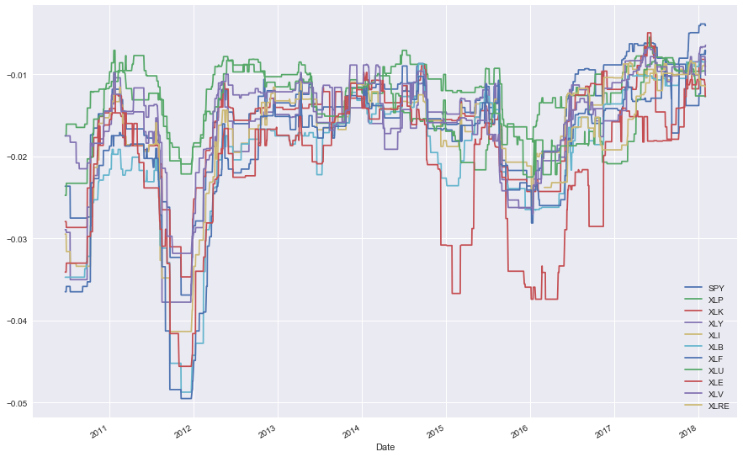
Rolling Var with window 100 Days

Slide 9
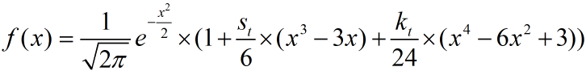
Gram-Charlier
Where St and Kt stands for Skewness and Kurtosis respectively.

Slide 10
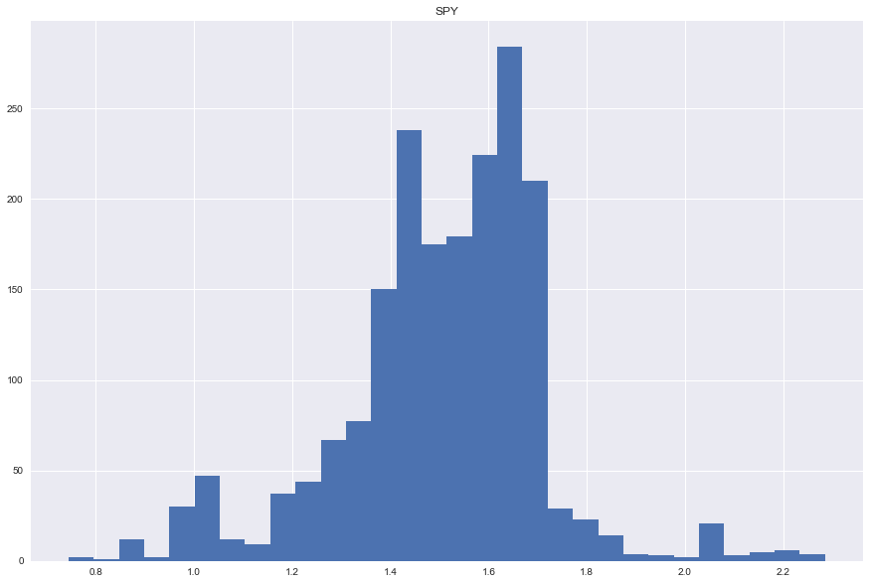
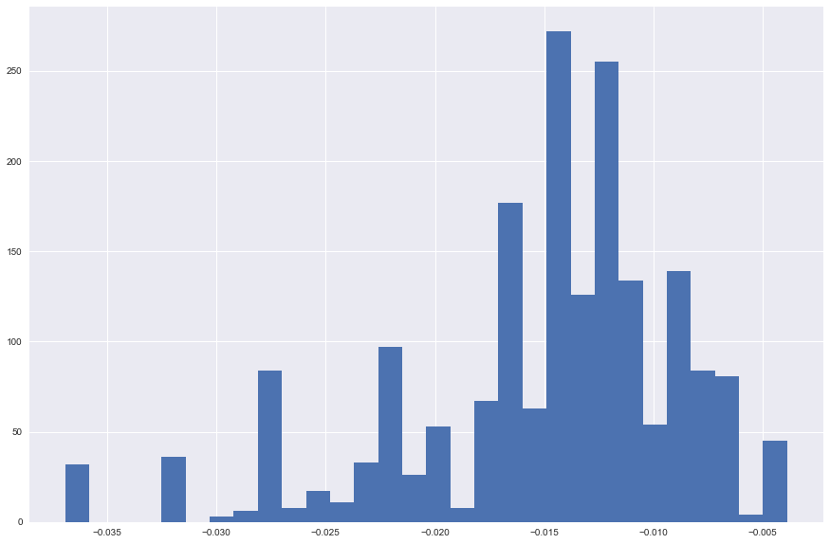
Gram-Charlier SPY 100-Day VaR vs Empirical VaR

Slide 11
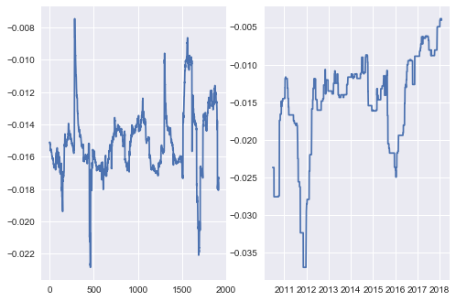
Gram-Charlier SPY 100-Day VaR vs Empirical VaR

Slide 12
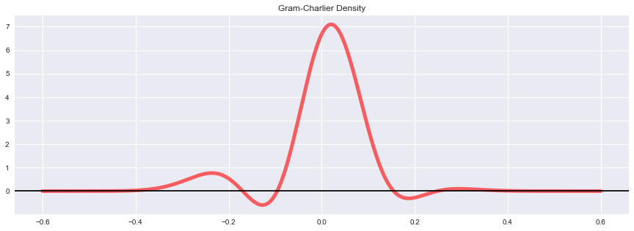
Gram-Charlier plot

Slide 13
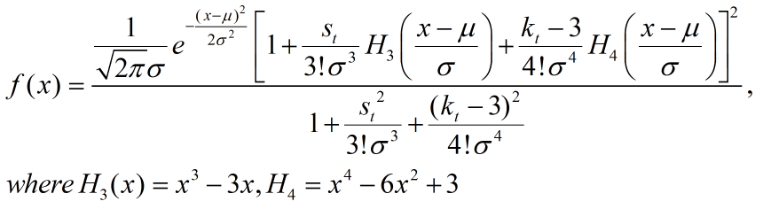
Positive Constraints For GC Density
To ensure positivity, Gallant and Tauchen (1989) square the polynomial part and divided by their integral over R.

Slide 14
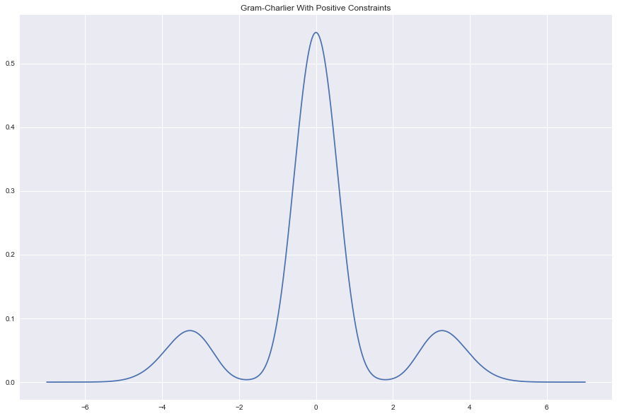
Positive Constraints For GC Density

Slide 15
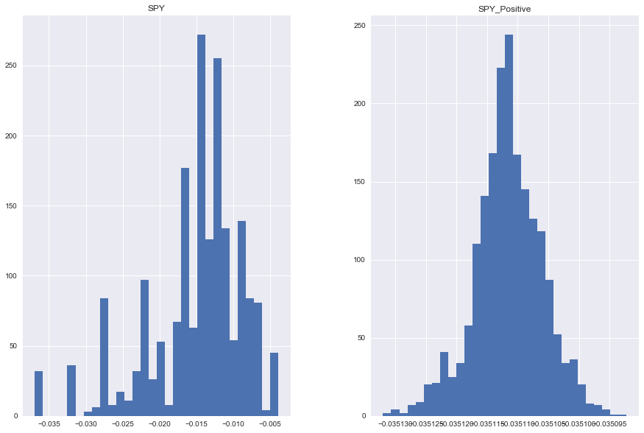
100 Rolling VaR Comparison

Slide 16
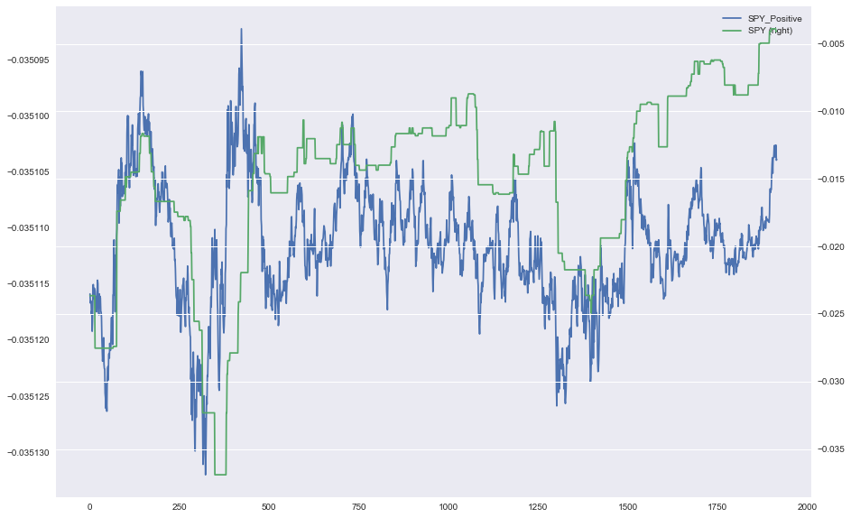
100 Rolling VaR Comparison

Slide 17
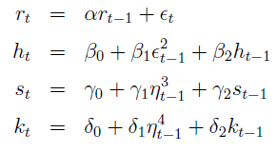
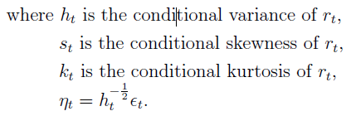
GARCH-Gram-Charlier
We present a financial Return model through GARCH(1,1) structure for conditional variance, skewness and kurtosis.
For the mean equation, we adapt a AR(1) process.
Thus our model is expressed as following:

Slide 18
Thank you

